Slide 1
KWH
2024-12-21

Slide 2
上週未處理完成部分

Slide 3
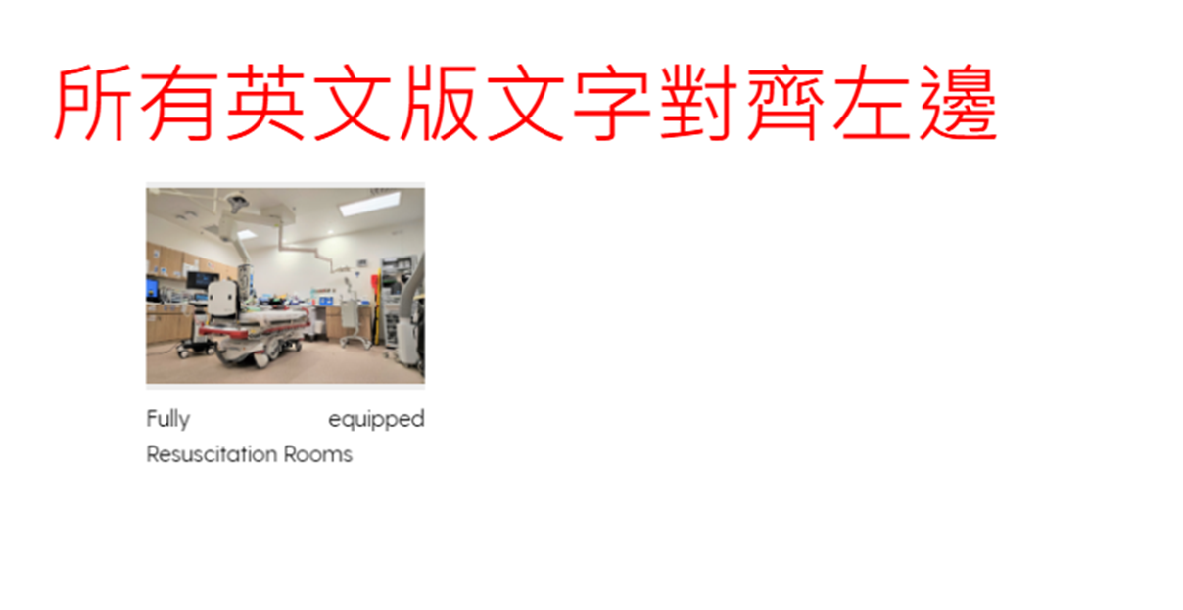
已修改

Slide 4
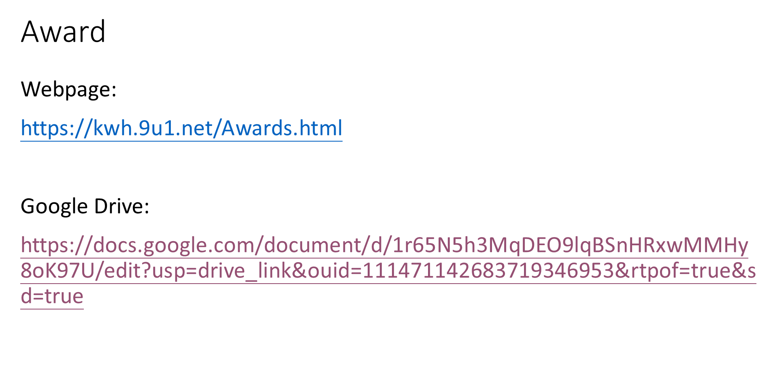
未完成

Slide 5
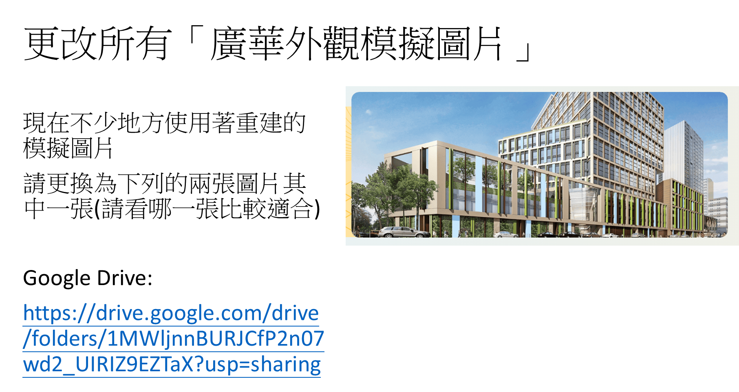
已修改

Slide 6
2024-12-16

Slide 7
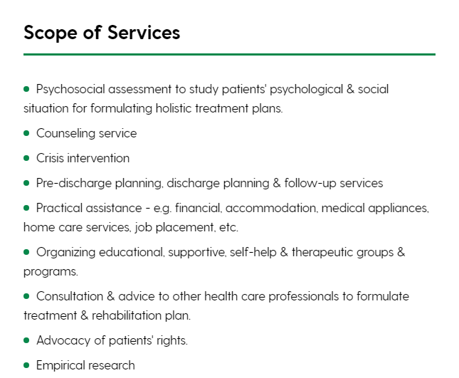
https://kwh.9u1.net/Services/Medical-Social-Service.html
已修改
英文版
Psychosocial assessment - to study patients' psychological & social situation for formulating holistic treatment plans.
Counseling service
Crisis intervention
Pre-discharge planning, discharge planning & follow-up services
Practical assistance - e.g. financial, accommodation, medical appliances, home care services, carer support, job placement, etc.
Organizing educational, supportive, self-help & therapeutic groups & programs.
Consultation & advice to other health care professionals to formulate treatment & rehabilitation plan.
Advocacy of patients' rights.
Empirical research

Slide 8
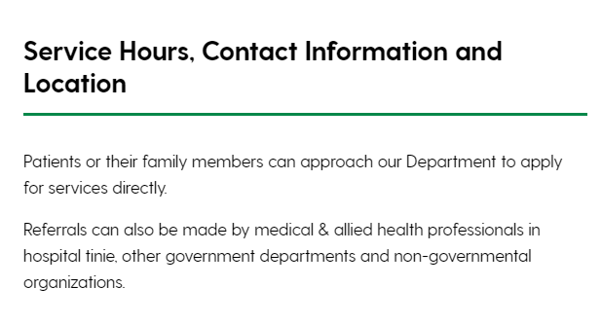
https://kwh.9u1.net/Services/Medical-Social-Service.html
已修改
英文版
Patients or their family members can approach our Department to apply for services directly.
Referrals can also be made by medical & allied health professionals in hospital tinie, other government departments and non-governmental organizations.

Slide 9
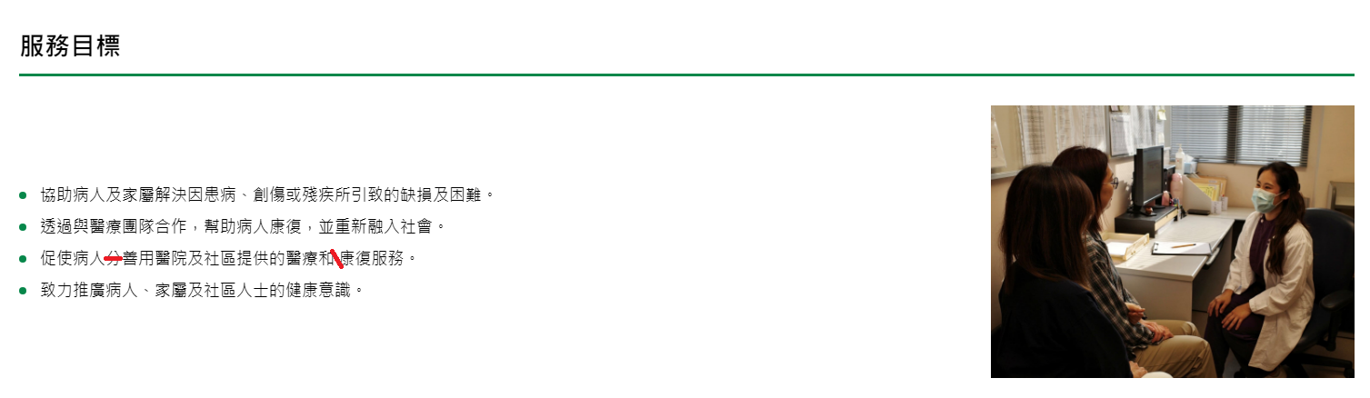
https://kwh.9u1.net/Services/Medical-Social-Service.html
已修改
更改內容
促使病人善用醫院及社區提供的醫療和康復服務。

Slide 10
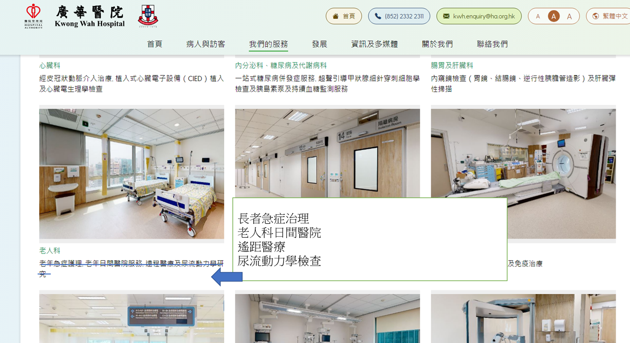
https://kwh.9u1.net/Services/Medicine-And-Geriatrics.html
已修改
繁體中文尚未更改

Slide 11

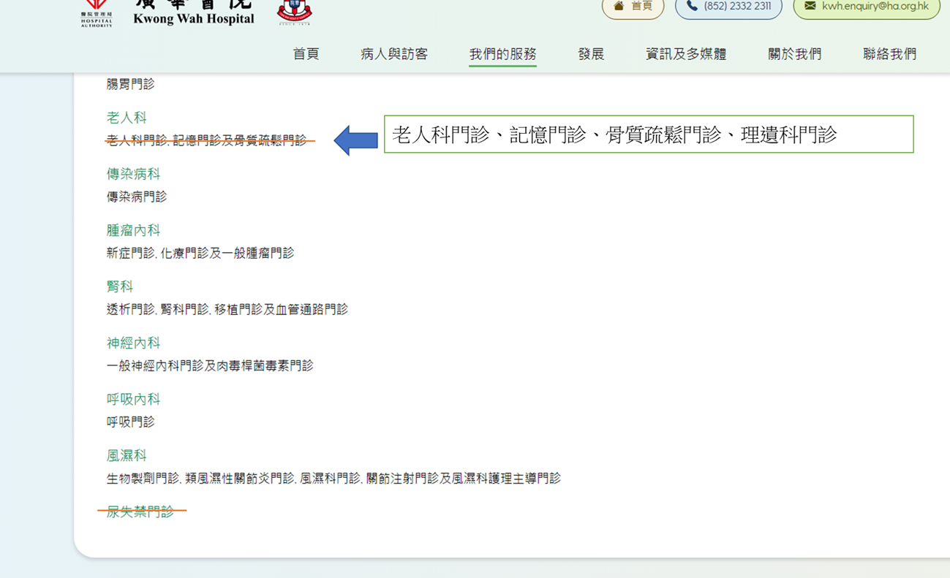
https://kwh.9u1.net/Services/Medicine-And-Geriatrics.html
已修改
簡體中文內容更改錯誤

Slide 12
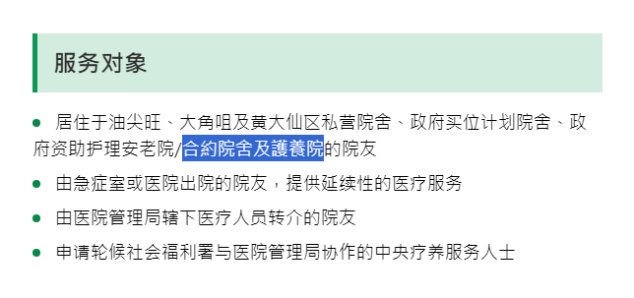
https://kwh.9u1.net/Services/Community-Nursing-Service.html?lang=zh-cn
未完成
簡體中文未更改
合约院舍及护养院的院友

Slide 13
https://kwh.9u1.net/overview.html
已修改
Tung Wah Group of Hospitals東華三院 鏈結:
英文版:https://www.tungwah.org.hk/en/ 繁體中文版:https://www.tungwah.org.hk/ 簡體中文版:https://sc.tungwah.org.hk/gate/gb/www.tungwah.org.hk/
Hospital Authority醫院管理局 鏈結:
英文版:https://www.ha.org.hk/visitor/ha_index.asp?Content_ID=0&Lang=ENG&Dimension=100&Ver=HTML 繁體中文版:https://www.ha.org.hk/visitor/ha_index.asp?Content_ID=0&Lang=CHIB5&Dimension=100&Ver=HTML 簡體中文版:https://www.ha.org.hk/visitor/ha_index.asp?Content_ID=0&Lang=CHIGB&Dimension=100&Ver=HTML

Slide 14
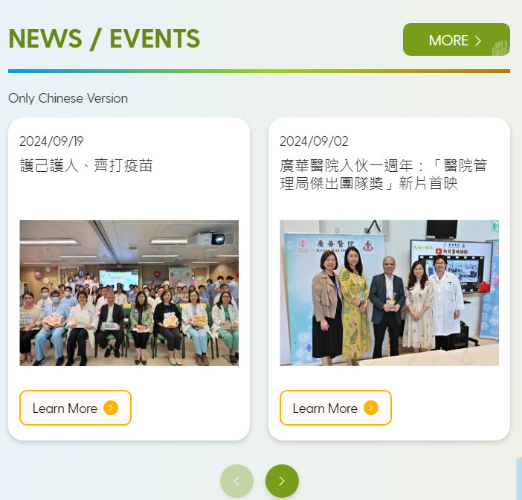
https://kwh.9u1.net/
已修改
根據活動日期排序
由新至舊

Slide 15
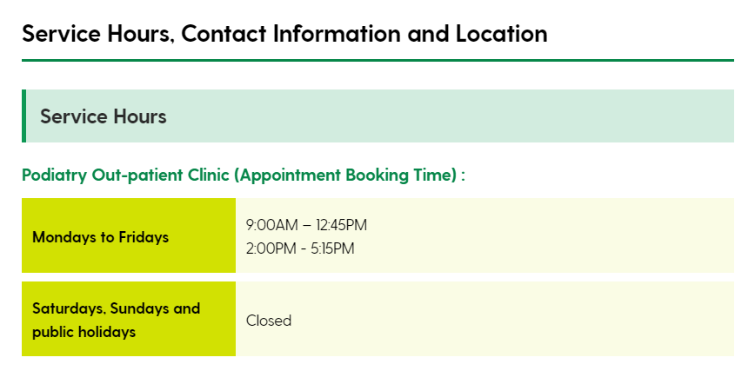
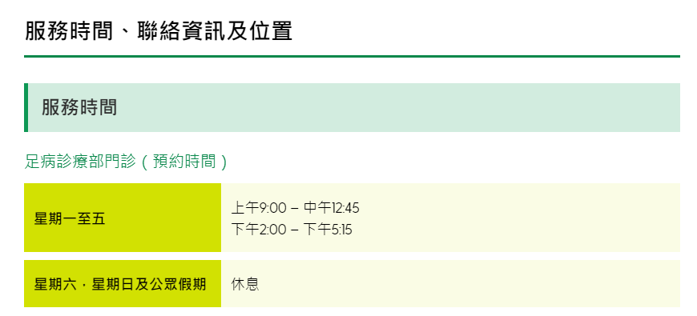
Podiatry https://kwh.9u1.net/Services/Podiatry.html
已修改
英文版更換為:
中文版更改為:
Mondays to Fridays | 9:00AM – 12:30PM 2:00PM - 5:00PM
星期一至五 | 上午9:00 – 中午12:30 下午2:00 – 下午5:00

Slide 16
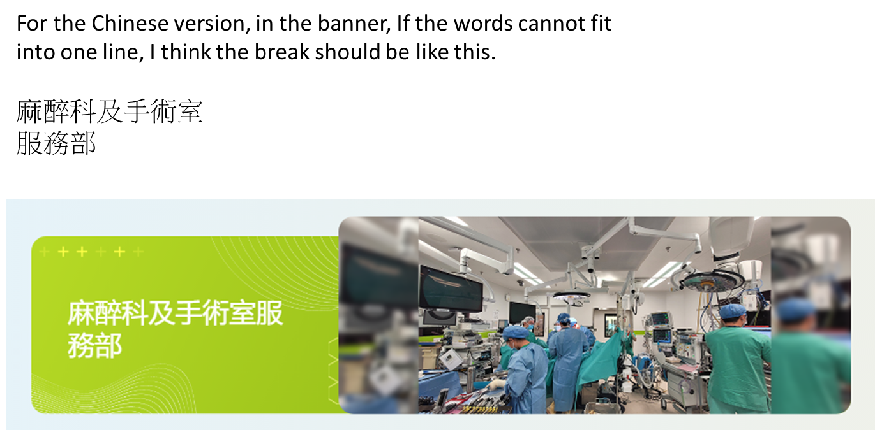
Anaesthesiology & Operating Theatre Services https://kwh.9u1.net/Services/Anaesthesiology-Operating-Theatre-Services.html
需要加<br>, 強制把「服務部」移至同一行(下一行)
未完成

Slide 17
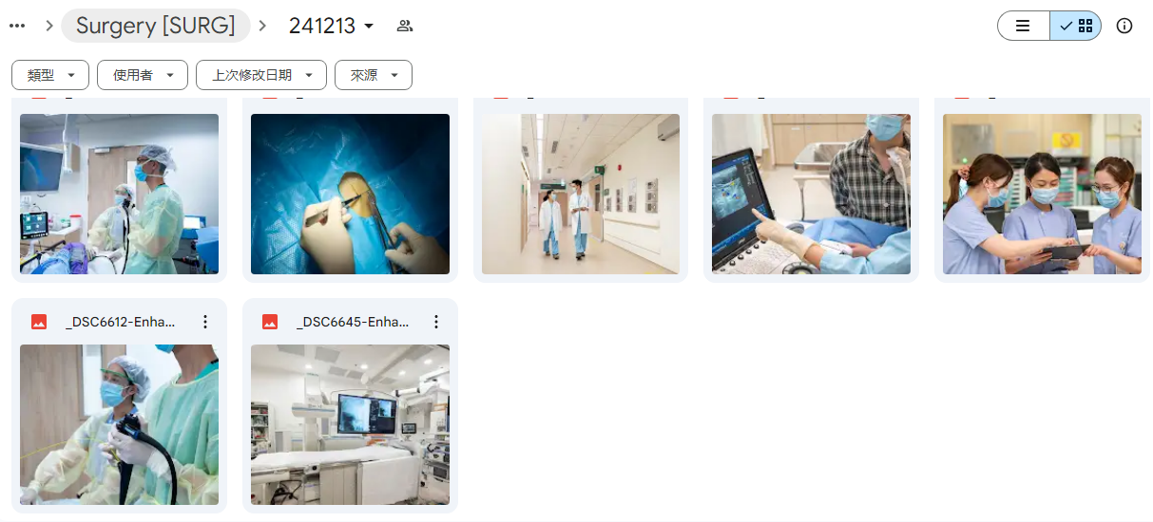
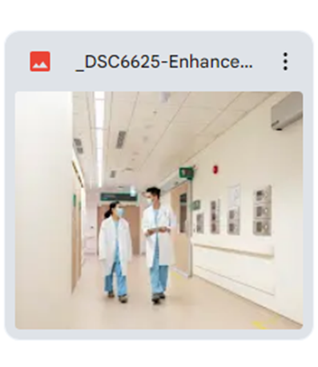

Surgery https://kwh.9u1.net/Services/Surgery.html
未完成
1.include all the photos from the google drive
DSC6559/6726/6674/6706/6625/6612/6645
2.omit all the watermark photos from the 9u1 website template
3.add and purchase the following photos from shutterstock
https://www.shutterstock.com/image-photo/doctor-breast-anatomy-model-augmentation-surgery-2368268165
https://www.shutterstock.com/image-photo/magnifying-glass-colon-diseases-colorectal-cancer-2464856059
https://www.shutterstock.com/image-photo/varicose-veins-on-womans-legs-1120340792
https://www.shutterstock.com/image-photo/cirrhosis-liver-cancer-fatty-asian-doctor-2533452569
https://www.shutterstock.com/image-photo/hyperthyroidism-overactive-thyroid-lymphoma-asian-doctor-2534910417
4. Please use 6625 from the google drive as the cover photo.
可以先嘗試上字下圖既效果

Slide 18
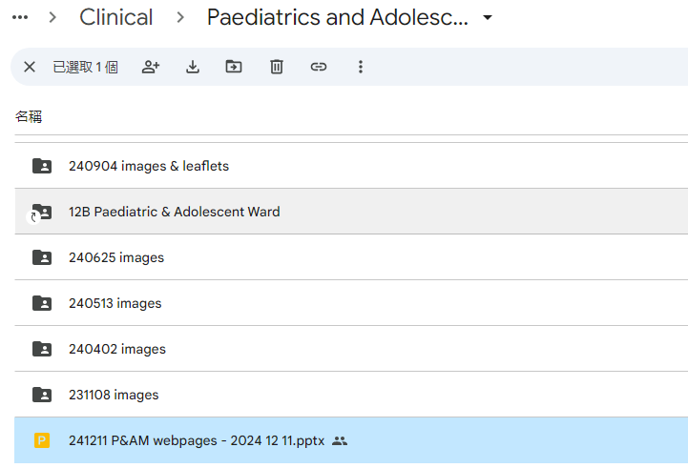
Paediatrics and Adolescent Medicine
https://kwh.9u1.net/Services/Paediatrics-And-Adolescent-Medicine.html?lang=hk
Comments as below: 241211 P&AM webpages - 2024 12 11.pptx
看P.36的更新PPT

Slide 19
https://kwh.9u1.net/Services/Speech-Therapy.html
未完成
更改內容
Google Drive:
https://drive.google.com/drive/u/2/folders/1773S-83BYnnQxFiktBBpEuy3JbtgYZYL

Slide 20
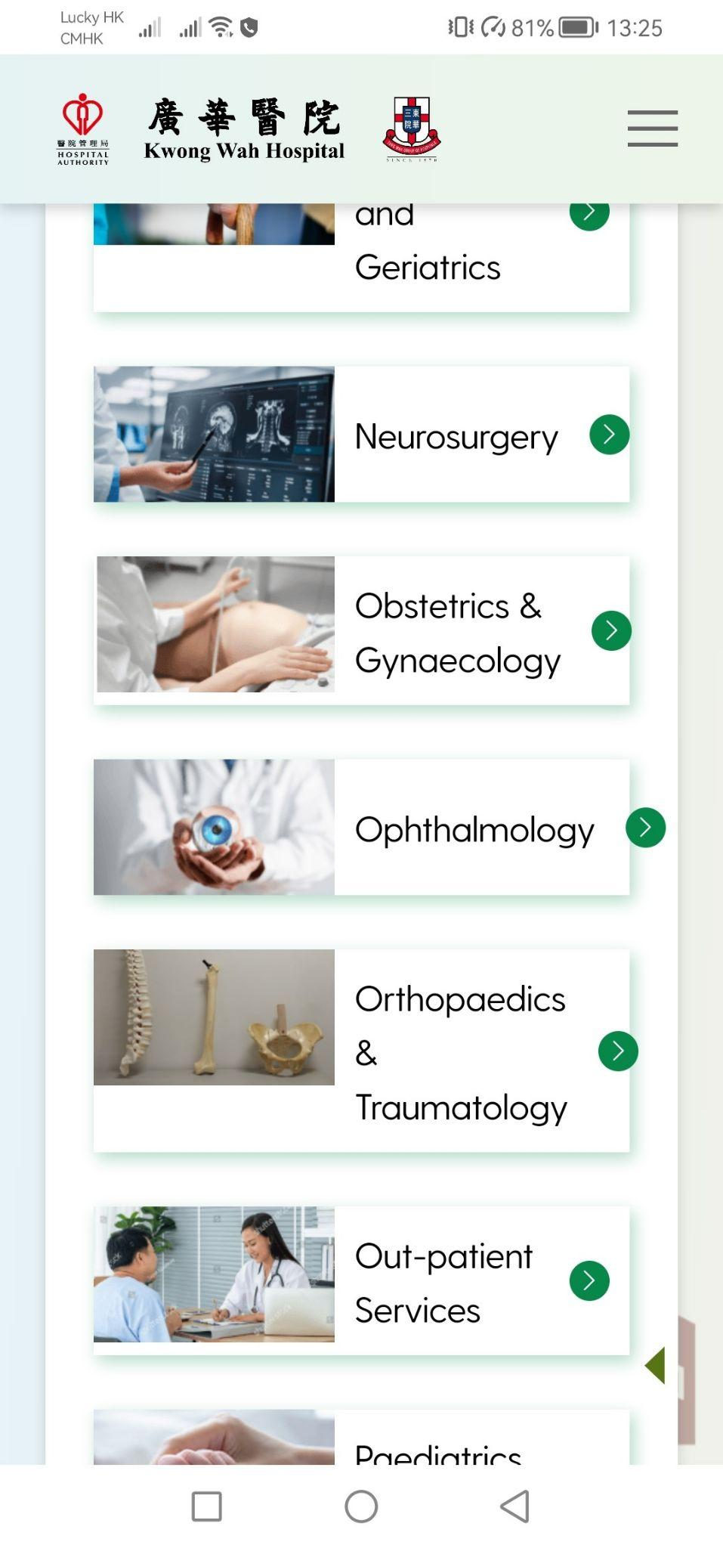
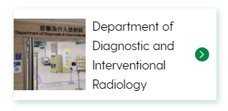
Our Service
未完成
Link: https://kwh.9u1.net/Our-Services.html
排版問題(右圖)
請更改為「左圖右字」並圖片為「正方形顯示」
(如下圖)

Slide 21
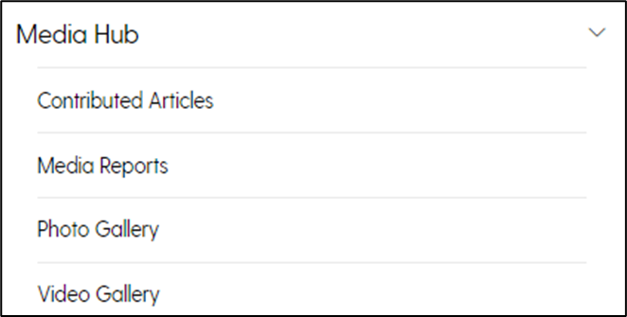
未完成
英文版
需要加上文字”Only Chinese Version”
https://kwh.9u1.net/Contributed-Articles.html
https://kwh.9u1.net/Media-Reports.html https://kwh.9u1.net/Photo-Gallery.html https://kwh.9u1.net/Video-Gallery.html

Slide 22
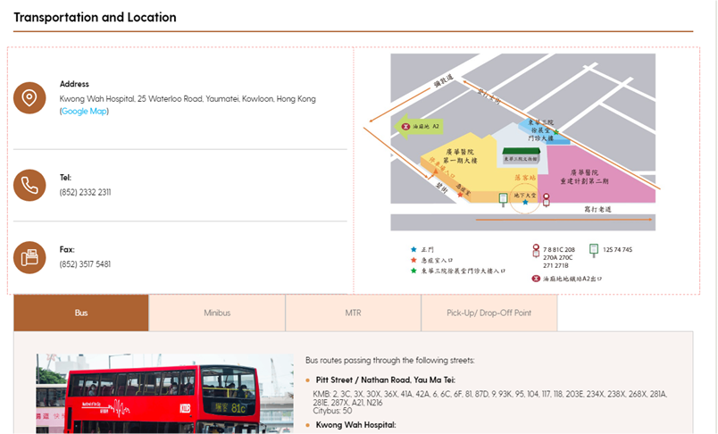
https://kwh.9u1.net/Visitors.html
未完成
把Google Map移除
並把地圖更換至Google Map位置
請根據語言更換地圖
Google Drive:
https://drive.google.com/drive/folders/1BZp52dBncovH5fBwefawCwBFcMJiiB8i?usp=drive_link

Slide 23


https://kwh.9u1.net/history.html
已修改
“In 2016”更改為”Main Works Package 1 of the KWH Redevelopment Project”
“In 2022”更改為”Completion of KWH Redevelopment Project Phase 1 Building”

Slide 24
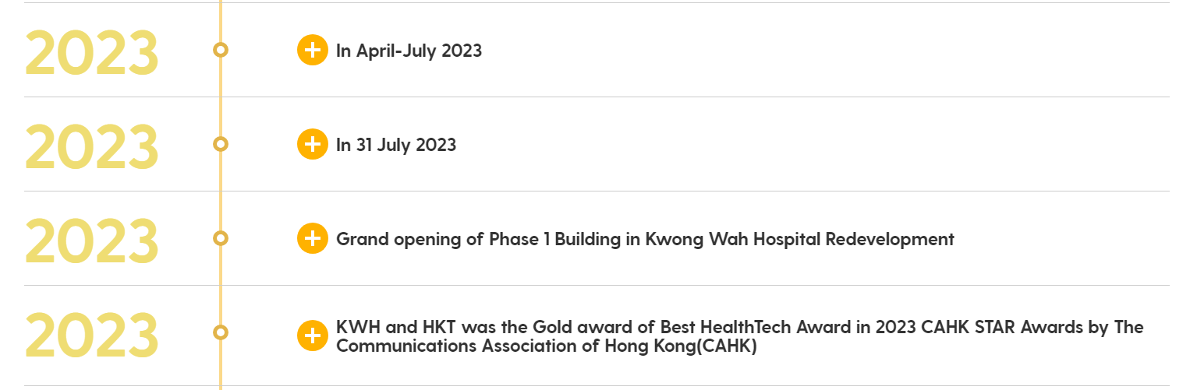
https://kwh.9u1.net/history.html
未完成
刪除多餘的2023
In April-July2023 更改為All services were relocated into the Phase 1 Building in phases during April to July 2023
In 31 July 2023 更改為The East Wing, North Wing, TWGHs Yu Chun Keung Memorial Centre and Staff Barracks were handed over to the main contractor in late July 2023

Slide 25
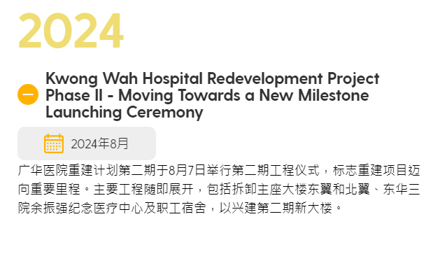
https://kwh.9u1.net/history.html
已修改
簡體中文版出現英文標題, 要修改:

Slide 26
2024-12-17

Slide 27
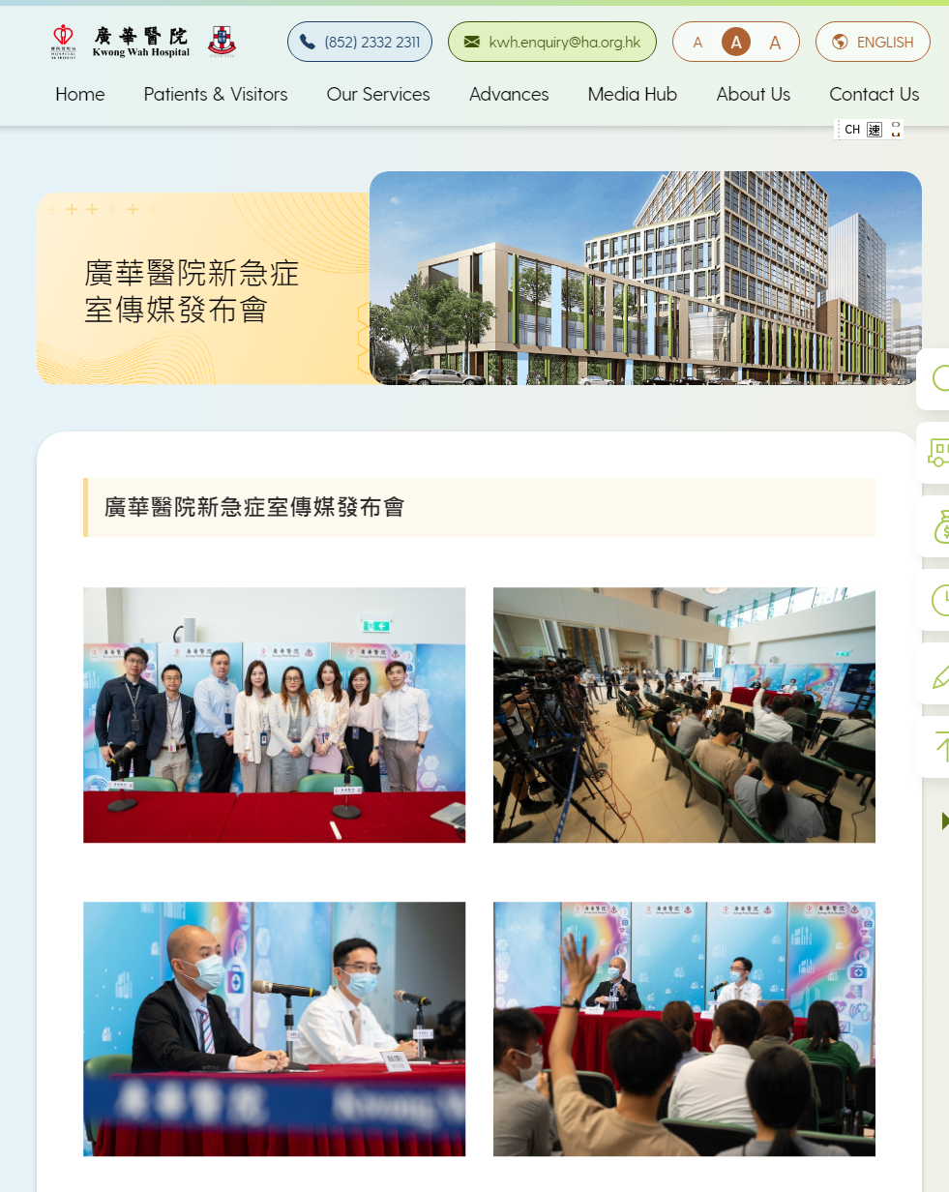
https://kwh.9u1.net/PhotoGalleryDetail.html?id=548&pageName=photo%20gallery
已修改
刪除第一張照片

Slide 28
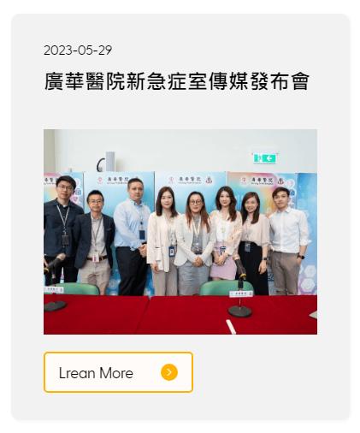
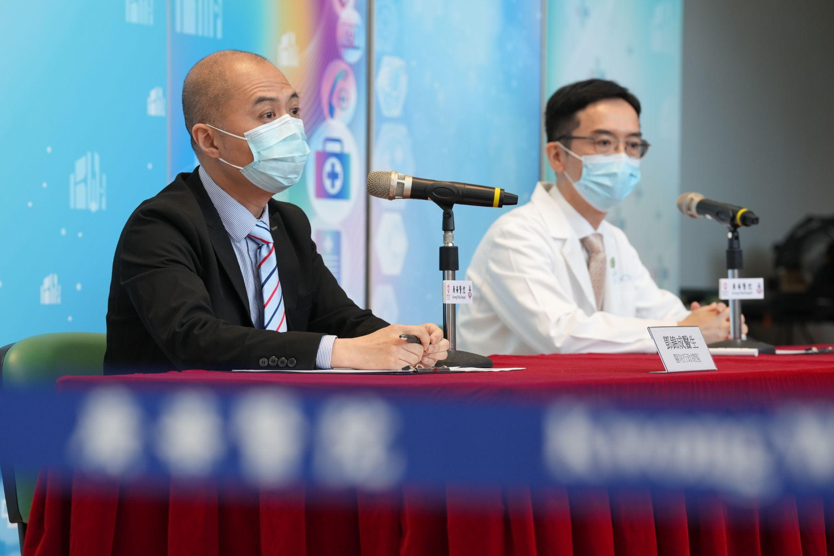
https://kwh.9u1.net/Photo-Gallery.html
已修改
圖片更換
Google Drive: https://drive.google.com/file/d/1IYF5FbwOBaU_V_RJBKT2FuqlmYel2LBg/view?usp=drive_link

Slide 29
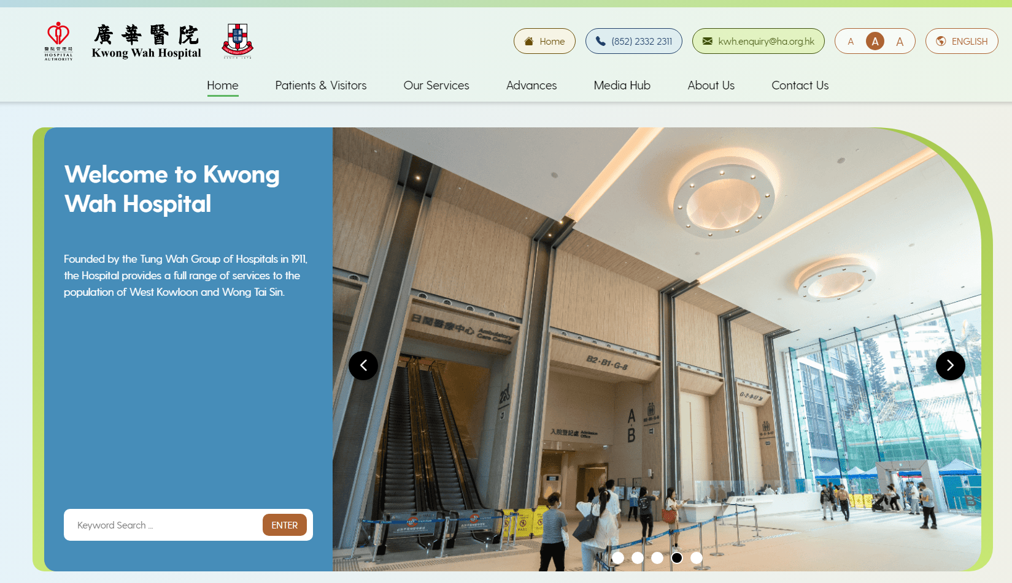
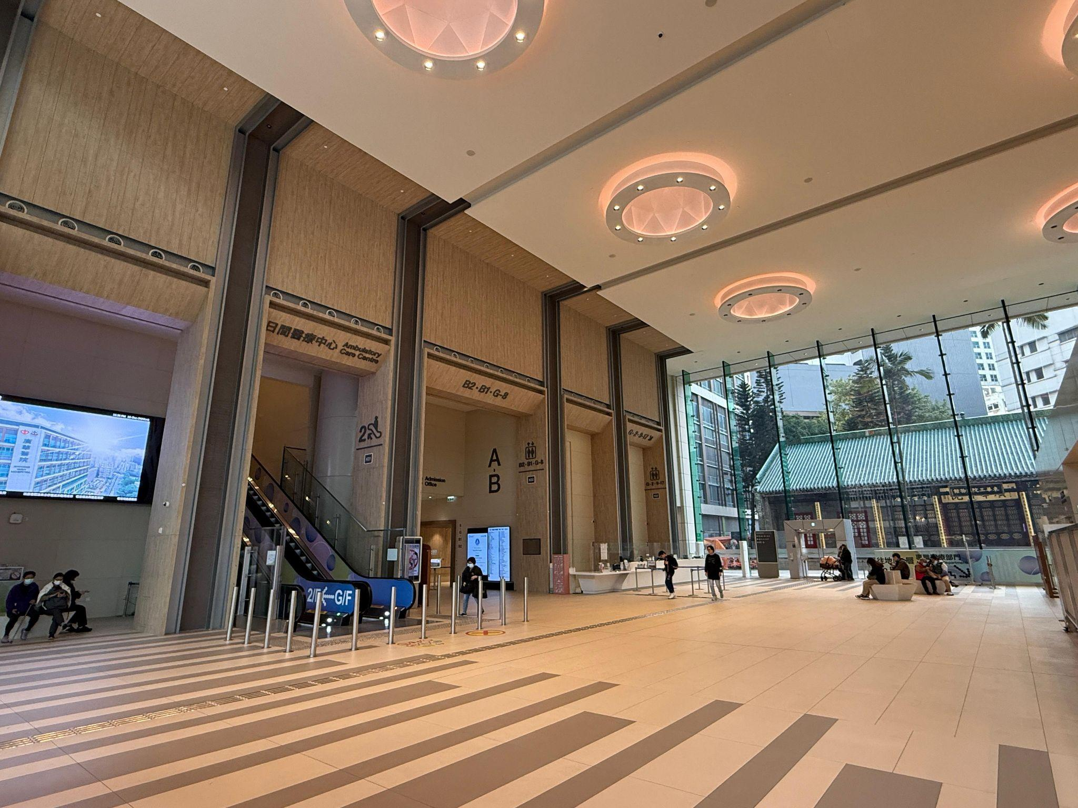
https://kwh.9u1.net/
未完成
圖片更換
Google Drive:
https://drive.google.com/file/d/1xV8wpbyqO-dFbRm-9uL-EU8ewhFknzOm/view?usp=drive_link

Slide 30
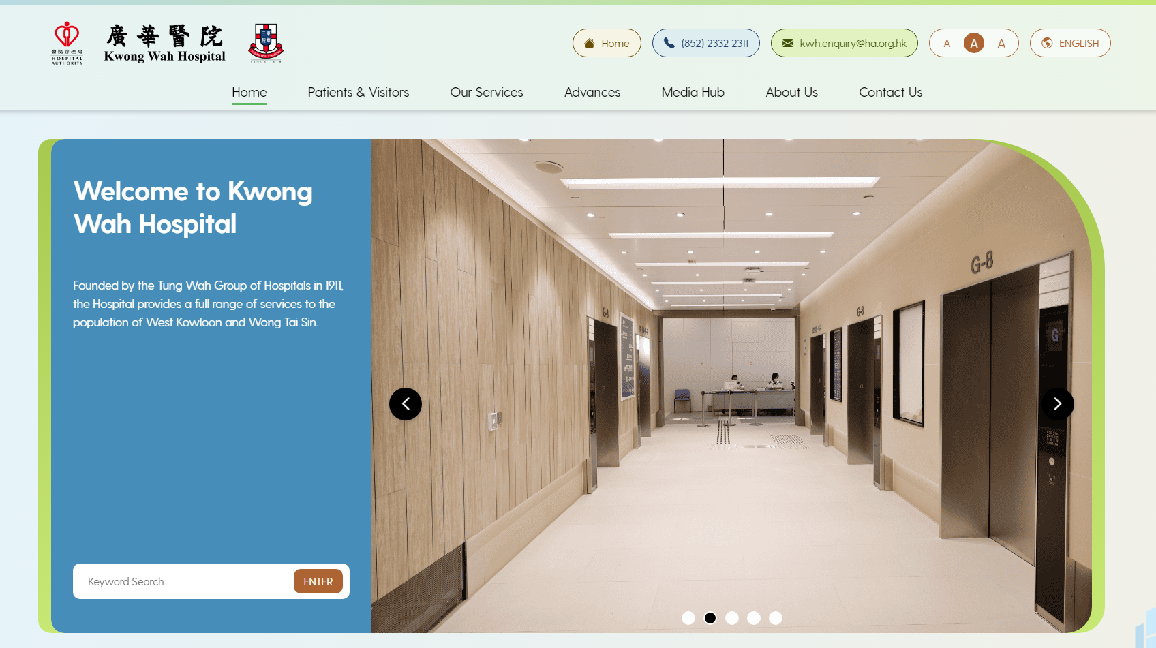
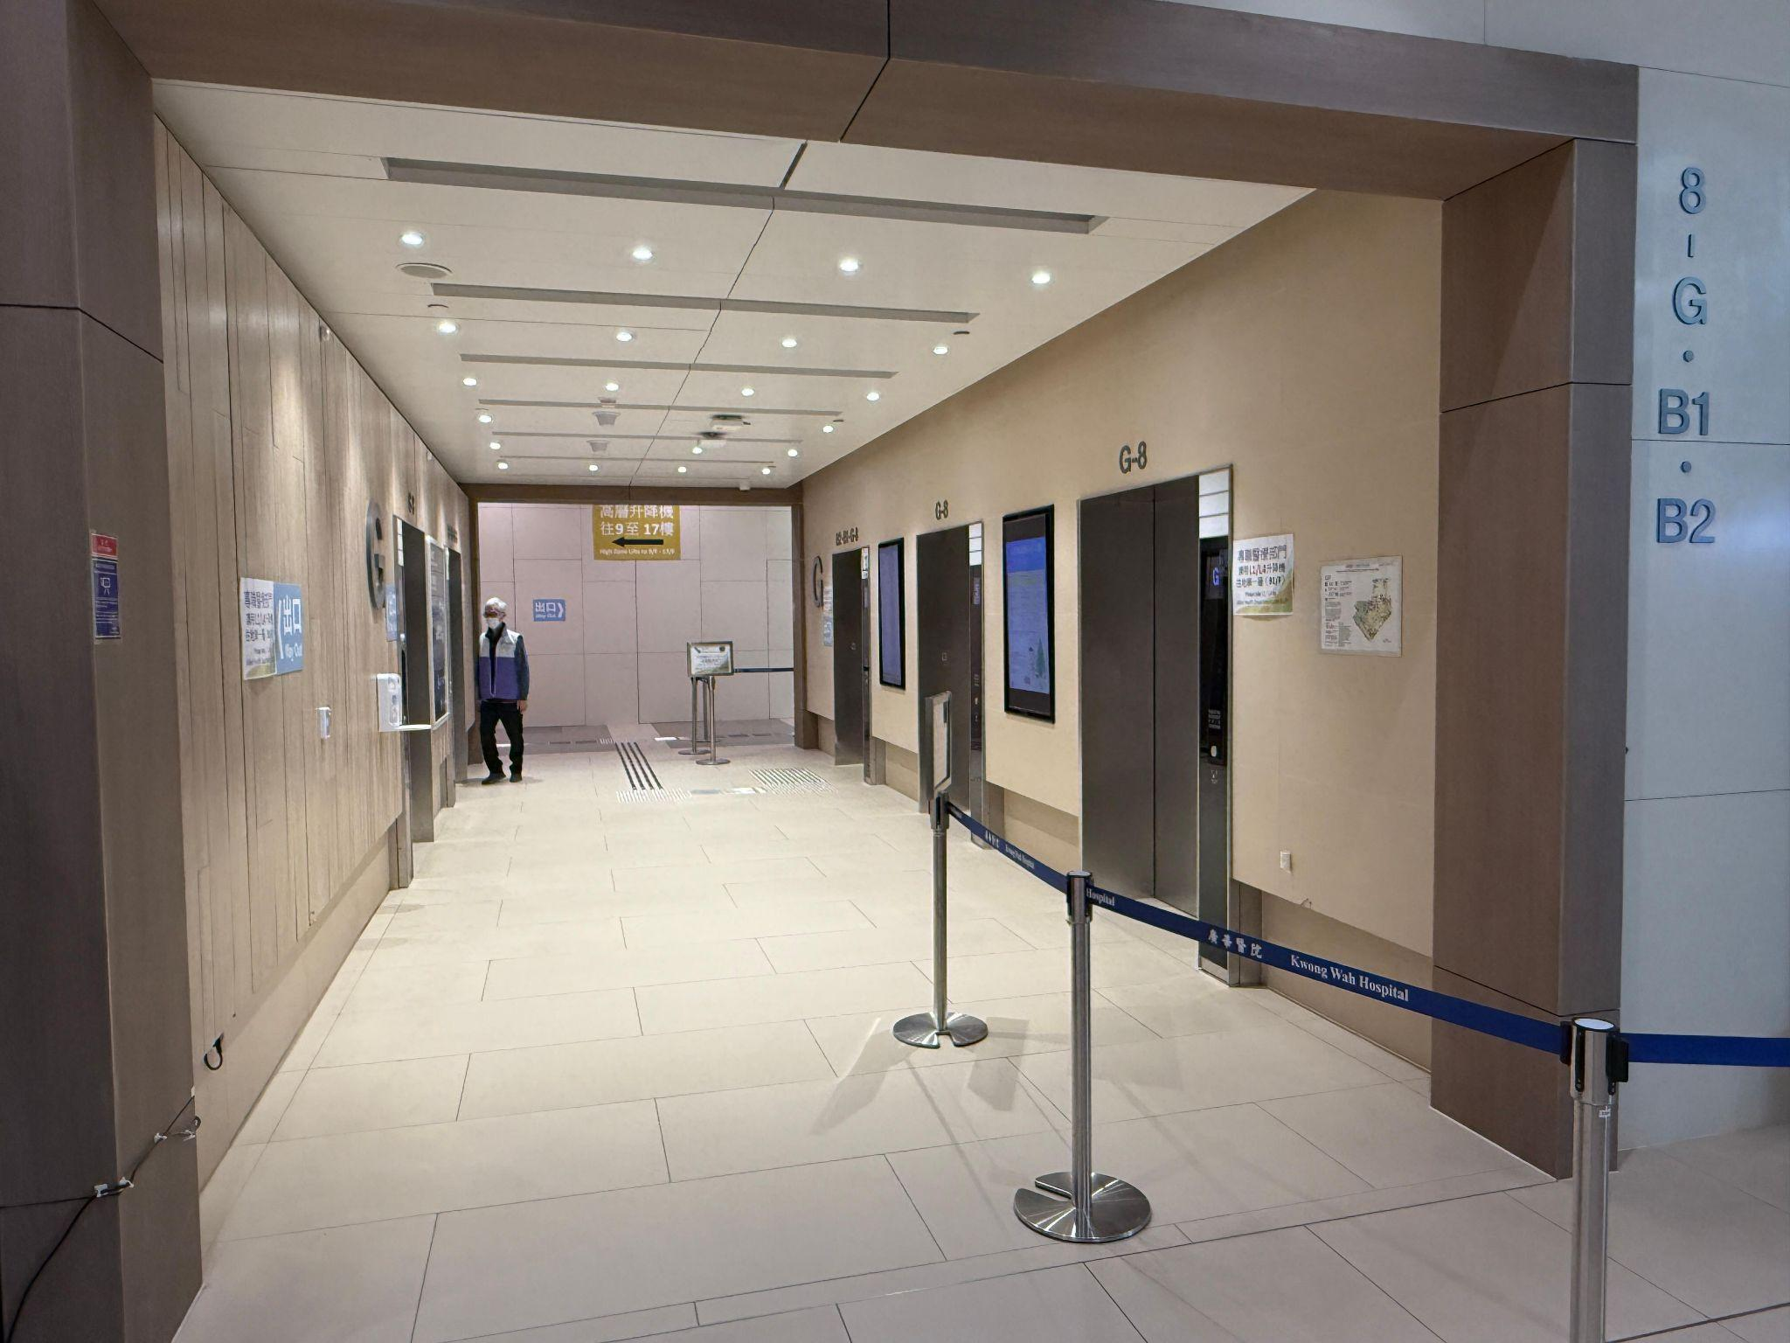
https://kwh.9u1.net/
未完成
圖片更換
Google Drive:
https://drive.google.com/file/d/1Nj7HTP5a2GPgvSTRLFEZS5xp_Q0riatm/view?usp=drive_link

Slide 31
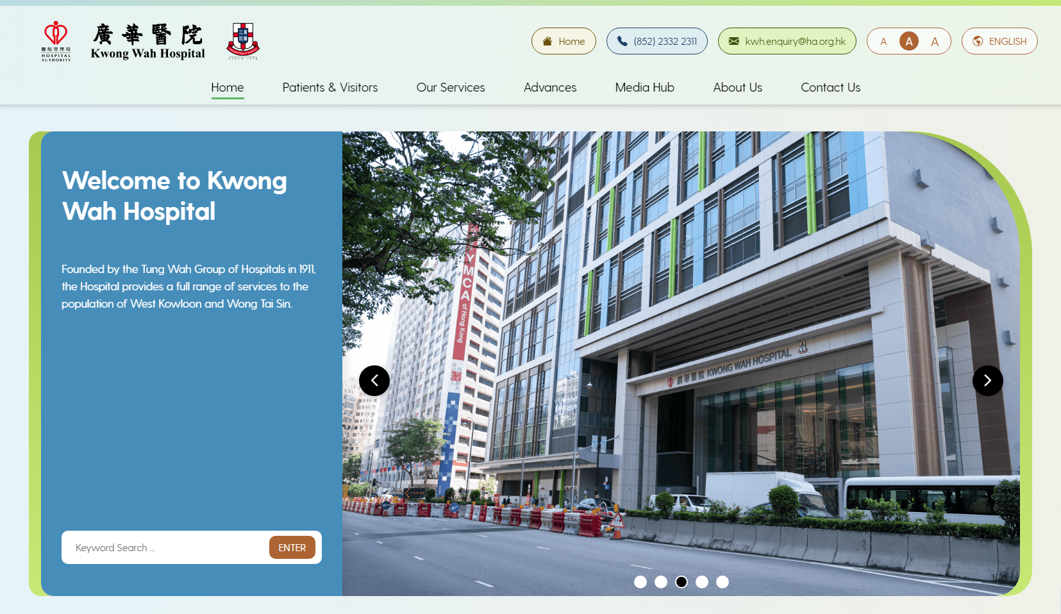
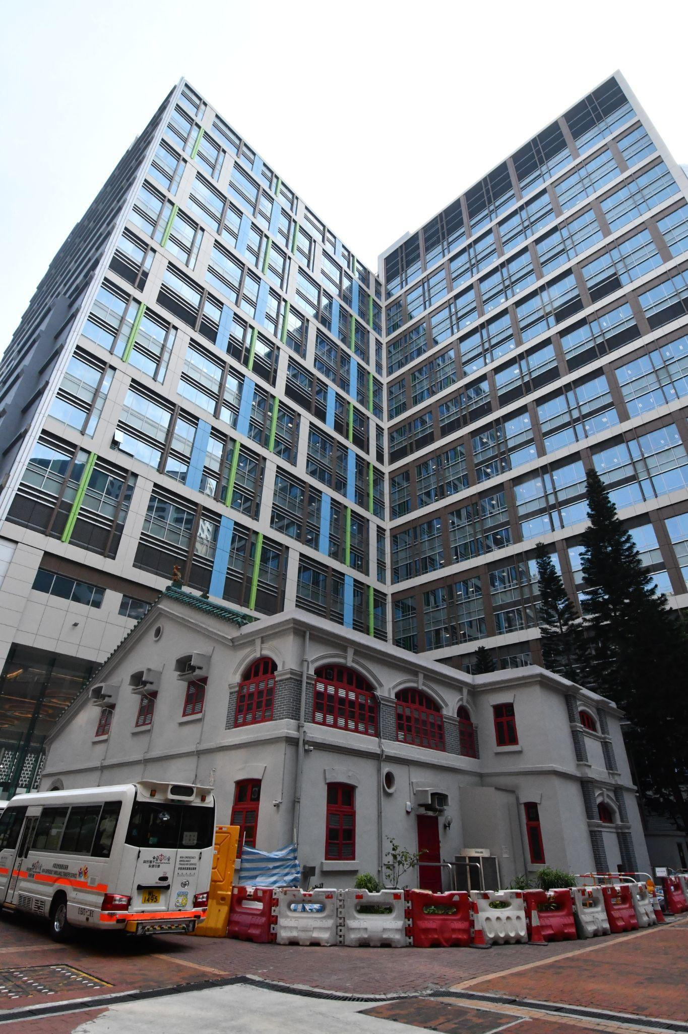
https://kwh.9u1.net/
未完成
圖片更換
Google Drive:
https://drive.google.com/file/d/1arb-ZKi4v30uEWG-VfnjkfyLedW-L-4o/view?usp=drive_link

Slide 32
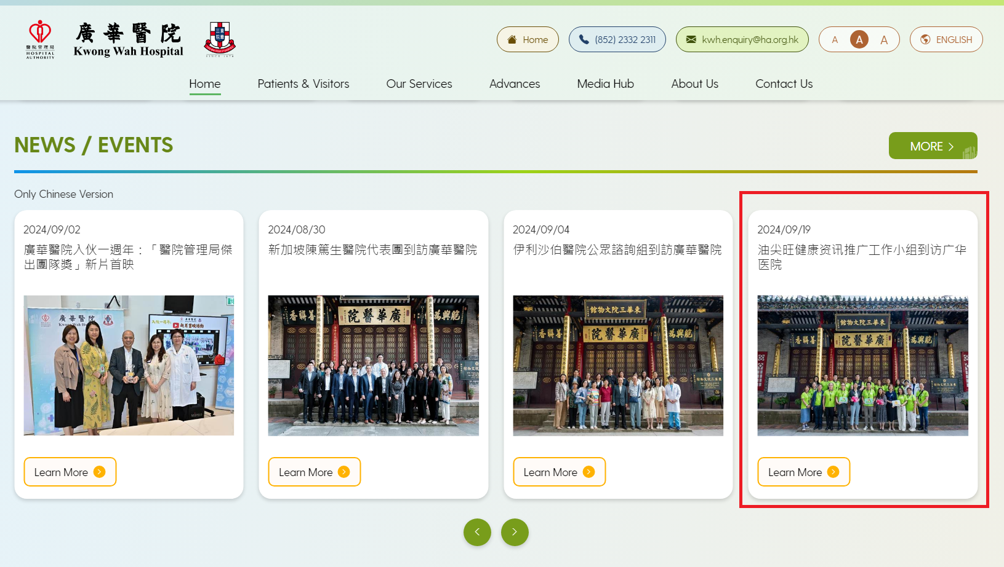
https://kwh.9u1.net/?lang=en
已修改
News & Event 英文版顯示了簡體中文

Slide 33
https://kwh.9u1.net/Media-Reports.html
未完成
新增內容
Google Drive: https://docs.google.com/document/d/1OkQykKFkTIkP2gwQ7Ir29hSqqfsp4sMn/edit?usp=drive_link&ouid=111471142683719346953&rtpof=true&sd=true
圖片:
https://drive.google.com/drive/folders/1-NHlfeA5SsWyj6jGxiBkDe_Mh5GwJjOw?usp=drive_link

Slide 34
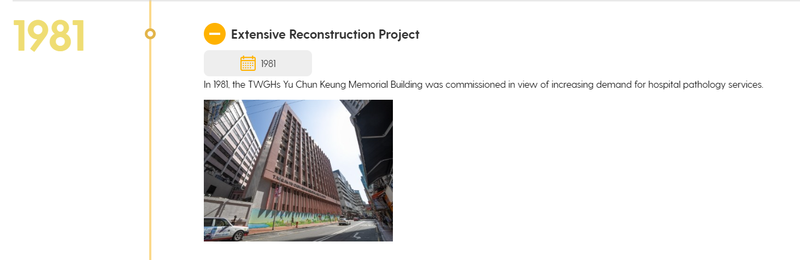
https://kwh.9u1.net/history.html
已修改
“TWGHs Yu Chun Keung Memorial Building” change to “TWGHs Yu Chun Keung Memorial Medical Centre”

Slide 35
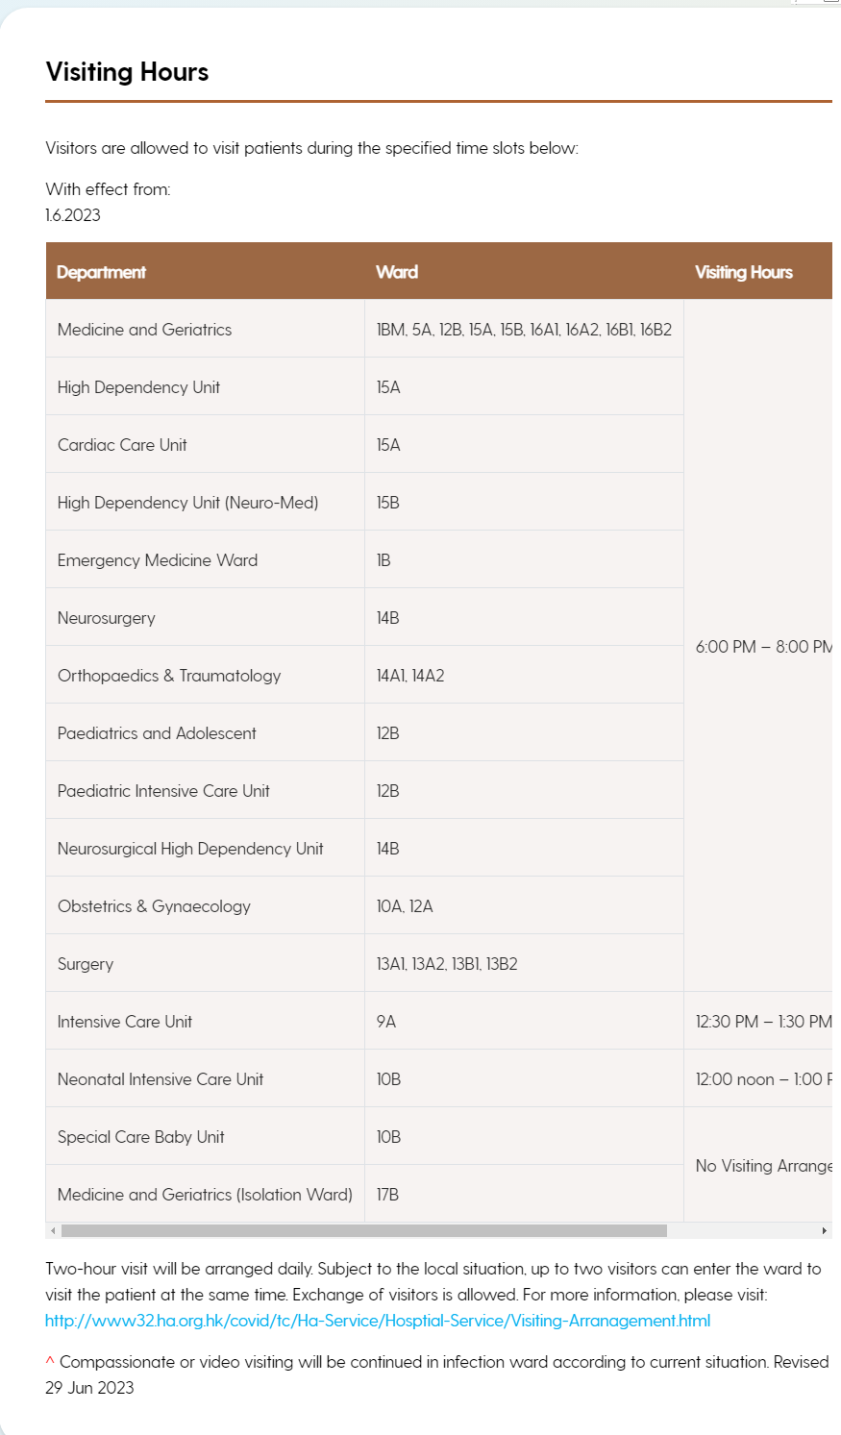
https://kwh.9u1.net/Visitors.html
已修改
更新內容
需要中文版顯示中文內容
英文版顯示英文內容
Google Drive:
https://docs.google.com/document/d/1rCBM6E7XtP_PPcsGV9m8tbMFXNWXjTQG/edit?usp=drive_link&ouid=111471142683719346953&rtpof=true&sd=true

Slide 36
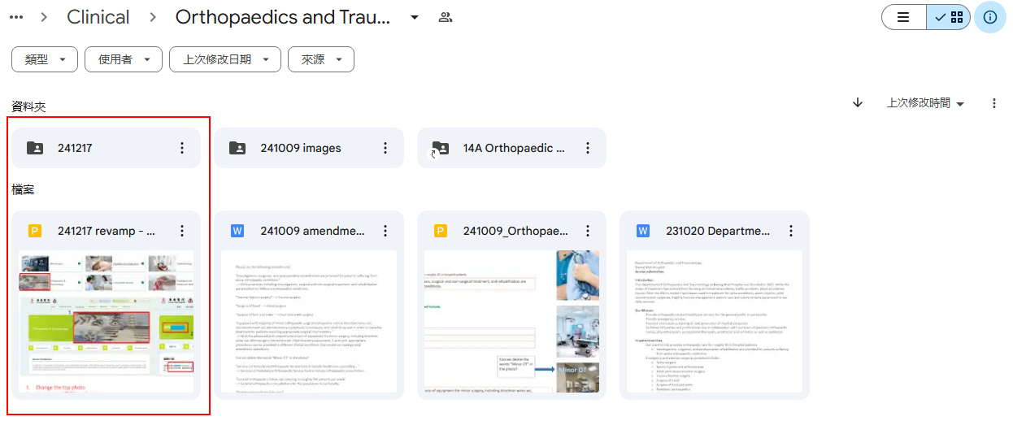
Orthopaedics & Traumatology
https://kwh.9u1.net/Services/Orthopaedics-And-Traumatology.html https://docs.google.com/presentation/d/1odKtd0YtUGW6ENRgx2GAGoJ-xo_FsqzO/edit#slide=id.p1 改為上字圖集形式
未完成

Slide 37
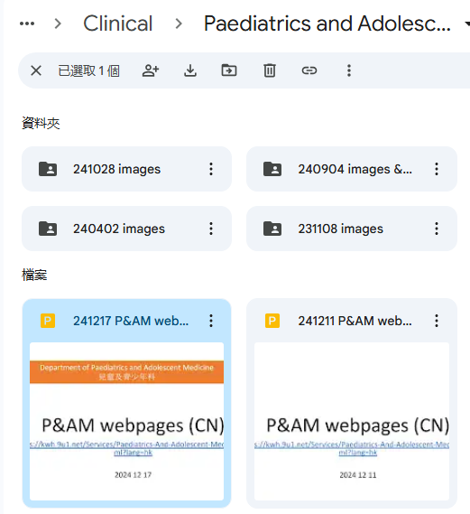
Paediatrics and Adolescent Medicine
https://kwh.9u1.net/Services/Paediatrics-And-Adolescent-Medicine.html
未完成
Additional comment from users (Added green star)

Slide 38
2024-12-18

Slide 39
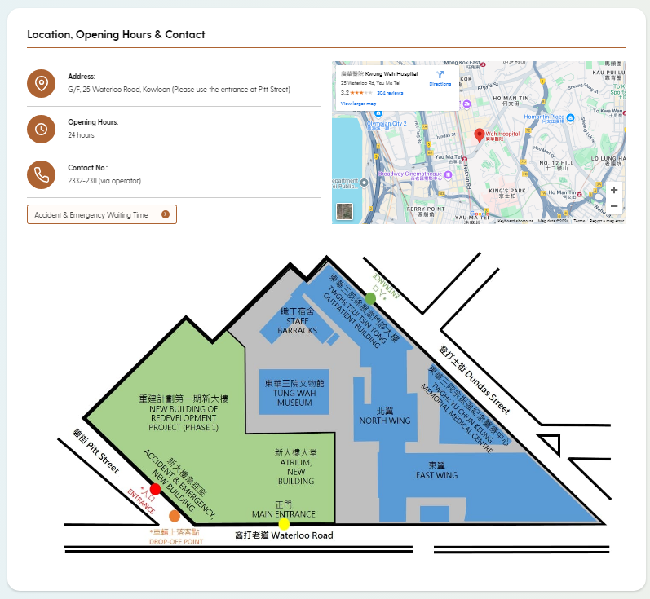
https://kwh.9u1.net/Emergency.html
未完成
請根據語言更換地圖
Google Drive:
https://drive.google.com/drive/folders/1BZp52dBncovH5fBwefawCwBFcMJiiB8i?usp=drive_link

Slide 40
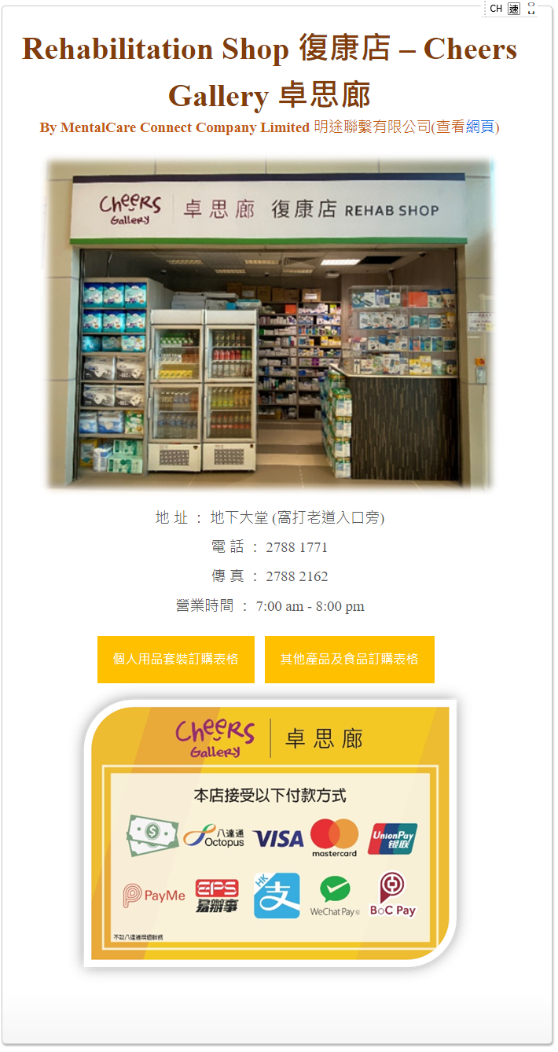
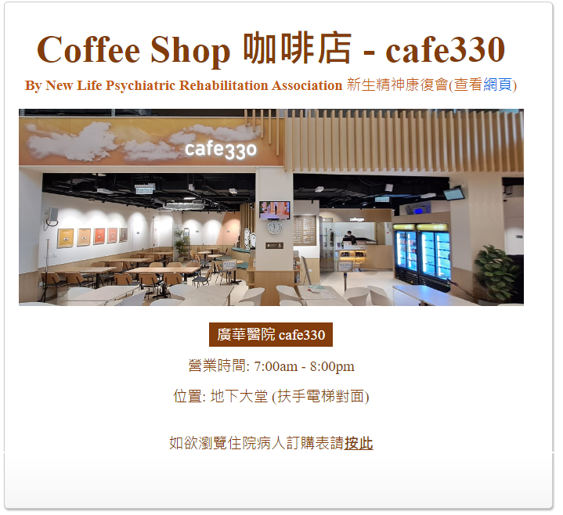
https://kwh.9u1.net/Visitors.html
未完成
新增「Facilities設施」(设施)
內容抄錄自
https://www3.ha.org.hk/kwh/main/tc/coffee-shop.asp
https://www3.ha.org.hk/kwh/main/tc/catering-shop.asp

Slide 41
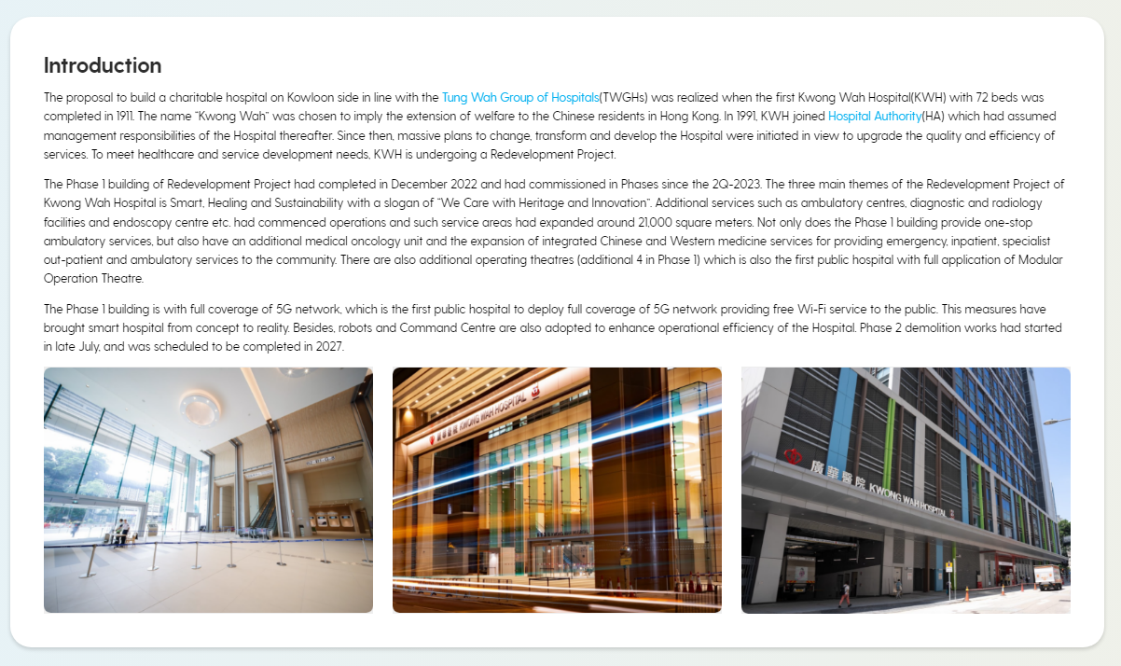
https://kwh.9u1.net/overview.html
已修改
刪除第一張圖片

Slide 42
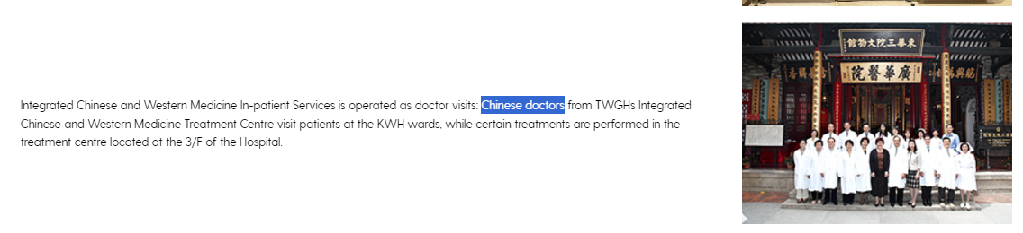
https://kwh.9u1.net/Services/Integrated-Chinese-Western-Medicine.html
已修改
Chinese doctors 更改為 Chinese Medicine Practitioners

Slide 43
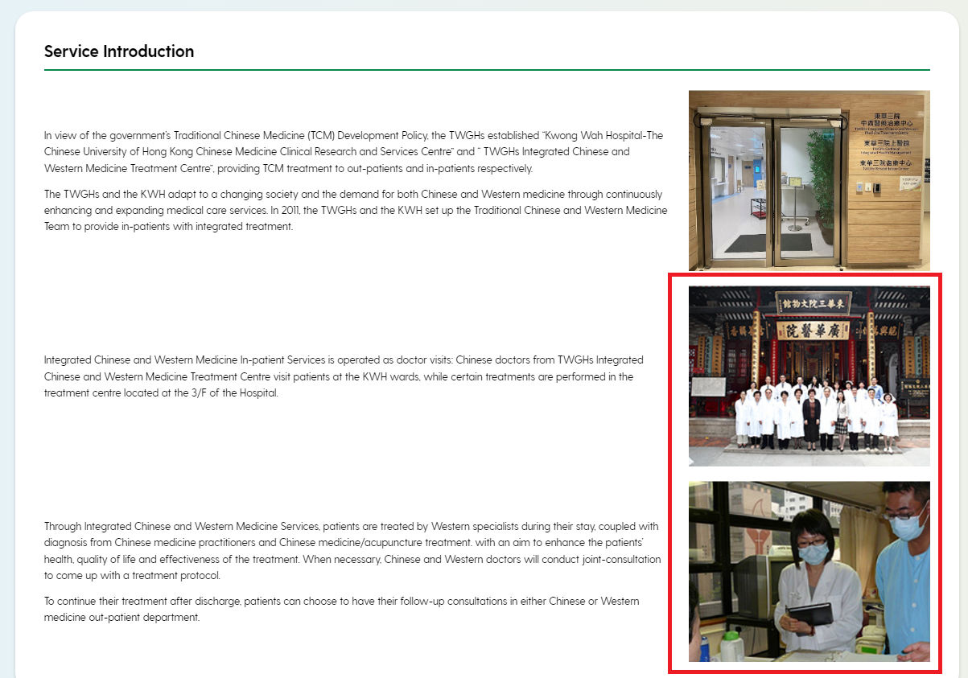
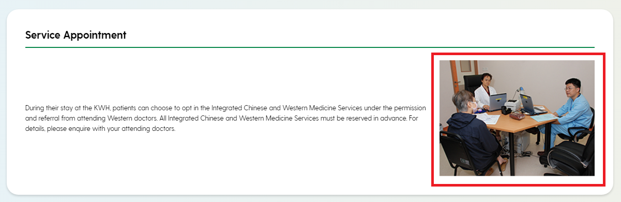
https://kwh.9u1.net/Services/Integrated-Chinese-Western-Medicine.html
已修改
更換高清圖片
Google Drive:
https://drive.google.com/drive/folders/15JHcl7KPN03ITJLGFHTsb_7TozPPkSNL?usp=drive_link

Slide 44
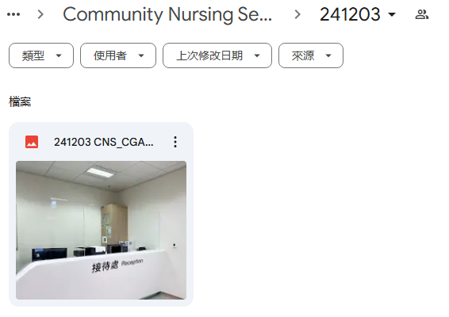
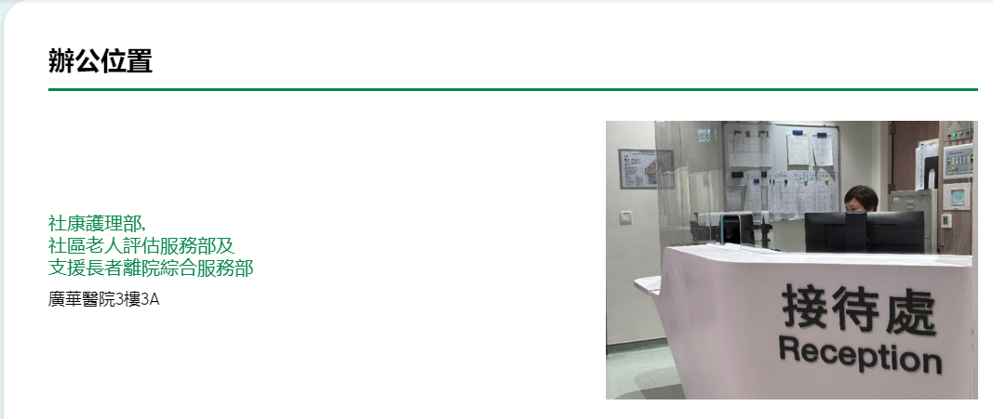
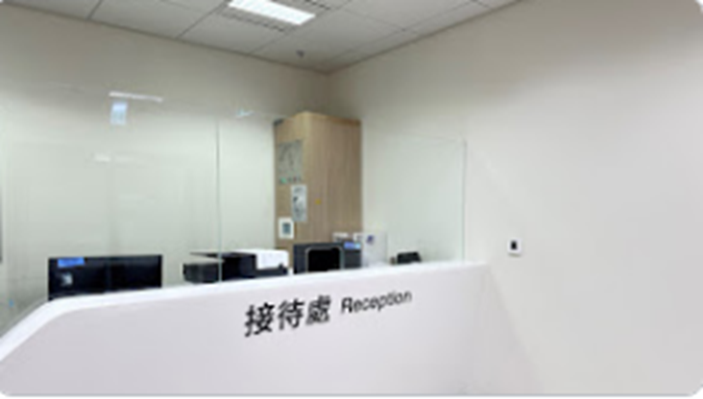
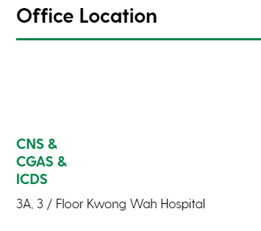
https://kwh.9u1.net/Services/Community-Nursing-Service.html
已修改
Change the photo
add new line to the location content in Chi & Eng
2
1
2

Slide 45
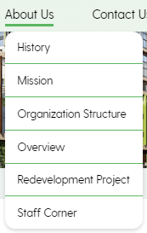
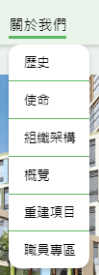
目錄的選項排序更新為
已修改
英文版
Overview
Orgainzation Structure
History
Mission
Redevelopment Project
Staff Corner
中文版
概覽
組織架構
歷史
使命
重建項目
職員專區

Slide 46
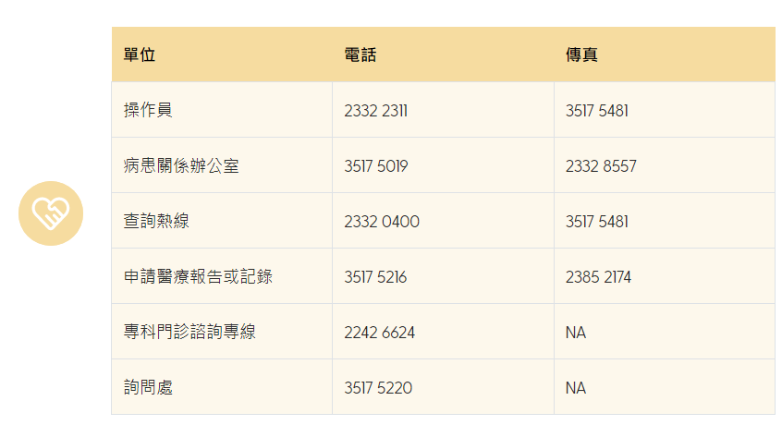
https://kwh.9u1.net/general-enquiry.html?lang=hk
已修改
單位 | 電話 | 傳真
醫院總機 | 2332 2311 | 3517 5481
病人聯絡辦公室 | 3517 5019 | 2332 8557
查詢熱線 | 2332 0400 | 3517 5481
申請醫療報告或記錄 | 3517 5216 | 2385 2174
專科門診查詢熱線 | 2242 6624 | NA
詢問處 | 3517 5220 | NA

Slide 47
2024-12-19

Slide 48
https://kwh.9u1.net/Visitors.html
已修改
內容更正
Google Drive:
https://docs.google.com/presentation/d/1NbZ603V4_WALzB0RVtV_X9TbDvJiZ5XE/edit?usp=drive_link&ouid=111471142683719346953&rtpof=true&sd=true

Slide 49

https://kwh.9u1.net/Visitors.html
已修改
Google Drive:
https://drive.google.com/drive/folders/1xyb-D7S9-byAkHrX8A0VLzzz5k5IWBo7?usp=drive_link
出生時間查詢
中文版:Birth Enquiry Application Form_Chin.pdf
英文版:Birth Enquiry Application Form_Eng.pdf
資料查閱請求
中文版:Data Access Request_查閱資料要求_Chinese.pdf
英文版:Data Access Request_查閱資料要求_English.pdf
醫療報告及病人資料申請
Medical Report Application_醫事報告申請.pdf

Slide 50


https://kwh.9u1.net/Services/Pharmacy.html
已修改
新增連結
英文版
“E-FILL” Drug Refill Service
https://www.ha.org.hk/visitor/ha_view_content.asp?Content_ID=241423&Lang=ENG&Dimension=100&Parent_ID=10081
Medication Delivery Service
https://www.ha.org.hk/visitor/ha_view_content.asp?Content_ID=270034&Lang=ENG&Dimension=100&Parent_ID=10081
繁體中文
「覆配易」覆配藥物服務
https://www.ha.org.hk/visitor/ha_view_content.asp?Content_ID=241423&Lang=CHIGB&Dimension=100&Parent_ID=10081
藥物送遞服務
https://www.ha.org.hk/visitor/ha_view_content.asp?Content_ID=270034&Lang=CHIB5&Dimension=100&Parent_ID=10081
簡體中文
「覆配易」覆配药物服务
https://www.ha.org.hk/visitor/ha_view_content.asp?Content_ID=241423&Lang=CHIB5&Dimension=100&Parent_ID=10081
药物送递服务
https://www.ha.org.hk/visitor/ha_view_content.asp?Content_ID=270034&Lang=CHIGB&Dimension=100&Parent_ID=10081

Slide 51



https://kwh.9u1.net/Services/Pharmacy.html
已修改
繁體中文
HA Go
https://www2.ha.org.hk/hago
「覆配易」覆配藥物服務
https://www.ha.org.hk/visitor/ha_view_content.asp?Content_ID=241423&Lang=CHIGB&Dimension=100&Parent_ID=10081
藥物送遞服務
https://www.ha.org.hk/visitor/ha_view_content.asp?Content_ID=270034&Lang=CHIB5&Dimension=100&Parent_ID=10081
簡體中文
HA Go
https://www2.ha.org.hk/hago/zh-cn/home
「覆配易」覆配药物服务
https://www.ha.org.hk/visitor/ha_view_content.asp?Content_ID=241423&Lang=CHIB5&Dimension=100&Parent_ID=10081
药物送递服务
https://www.ha.org.hk/visitor/ha_view_content.asp?Content_ID=270034&Lang=CHIGB&Dimension=100&Parent_ID=10081
新增「Useful Information實用資訊」
英文版
HA Go
https://www2.ha.org.hk/hago/en/home
“E-FILL” Drug Refill Service
https://www.ha.org.hk/visitor/ha_view_content.asp?Content_ID=241423&Lang=ENG&Dimension=100&Parent_ID=10081
Medication Delivery Service
https://www.ha.org.hk/visitor/ha_view_content.asp?Content_ID=270034&Lang=ENG&Dimension=100&Parent_ID=10081
圖片:
https://drive.google.com/drive/folders/18bYZzF_zE_vZt7Q3HsUnordm2D6sbRhU?usp=drive_link
次序如下:

Slide 52
https://kwh.9u1.net/Services/Accident-Emergency.html
未完成
內容更改
Google Drive:
https://docs.google.com/presentation/d/1jAIsms9MVqwroevSkKHtD0WivZ71-pGP/edit?usp=drive_link&ouid=111471142683719346953&rtpof=true&sd=true

Slide 53

https://kwh.9u1.net/Services/Health-Promotion-Centre.html
未完成
更換封面圖片
Google Drive:
https://drive.google.com/file/d/1cOjANzCLmKWzGfKd447bJz7JBs4lRmRO/view?usp=drive_link

Slide 54


https://kwh.9u1.net/Services/Health-Promotion-Centre.html
未完成

Slide 55


https://kwh.9u1.net/Services/Health-Promotion-Centre.html
未完成

Slide 56


https://kwh.9u1.net/Services/Health-Promotion-Centre.html
未完成

Slide 57

https://kwh.9u1.net/Services/Health-Promotion-Centre.html
未完成
中文版更正: 社區協作及建立夥伴關係
英文版更正
For enquiries, please contact our Health Promotion Centre at 3517 4677.
Facilitate patient support groups in organizing activities so as to establish a mutual support network among themselves.
Organize health-related programmes to enhance patients and carers’ quality of life

Slide 58
https://kwh.9u1.net/Services/Out-Patient-Services.html
未完成
更換圖片
Google Drive:
https://drive.google.com/drive/folders/1TG2M81EwxnUs8d_1CrCERw4JzdFlvezZ?usp=drive_link
封面照片: DSC6803
地圖
徐展堂門診大樓一樓 (GOPD TTT 1/F) : DSC6878
徐展堂門診大樓二樓 (SOPD TTT 2/F): DSC6891
徐展堂門診大樓三樓 (SOPD TTT 3/F): DSC6899

Slide 59
問題

Slide 60


https://kwh.9u1.net/Visitors.html?lang=en
在Visitors頁留意到有2處有寫「new building」, 但沒有收到通知要刪除, 請問是否保留?

Slide 61
Awards頁
由於跟據Google drive的資料與現在的版面設計不太相符
因此有關Awards頁簡單畫左設計圖, 請參考:
https://xd.adobe.com/view/06f12ea6-58e1-4b0b-ad7d-f520d3dce9e7-53a2/grid

